Slide 1
City of Stars, City of Crimes: Data-Driven Insights into LA’s Crime Reports
Haiying Lin, Nathaniel Zhu, Youyi Fu, Maohua Wu

Slide 2
Contents
01
02
03
04
Introduction
Descriptive Analysis
Model
Summary

Slide 3
01
Introduction

Slide 4
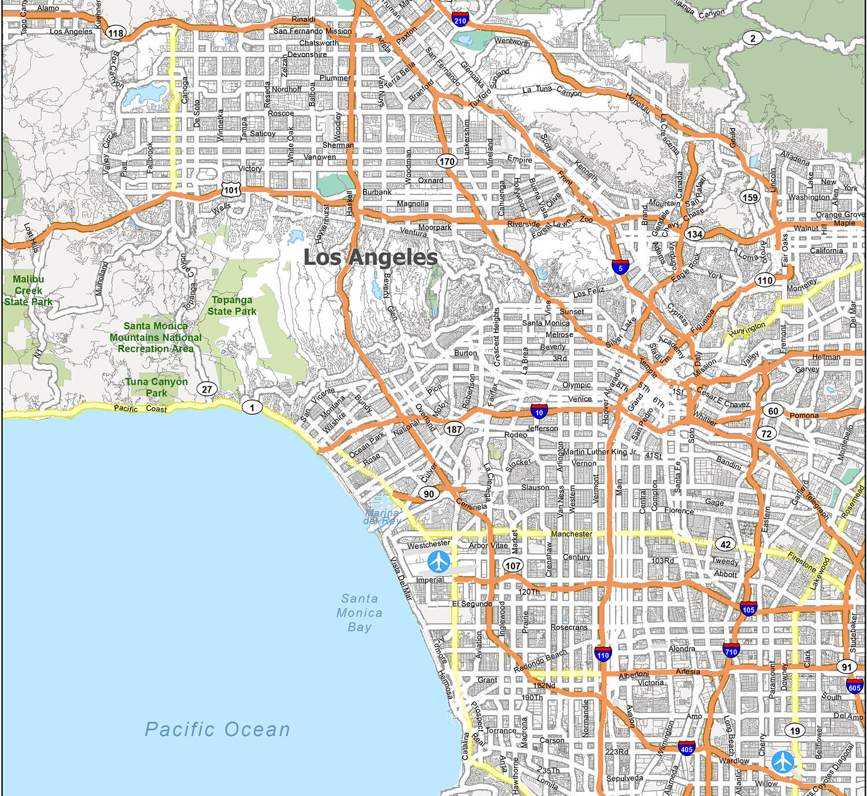
Why we want to delve into the crime data in LA?

Slide 5


Our Objectives:

Slide 6

Let’s See Some Data

Slide 7
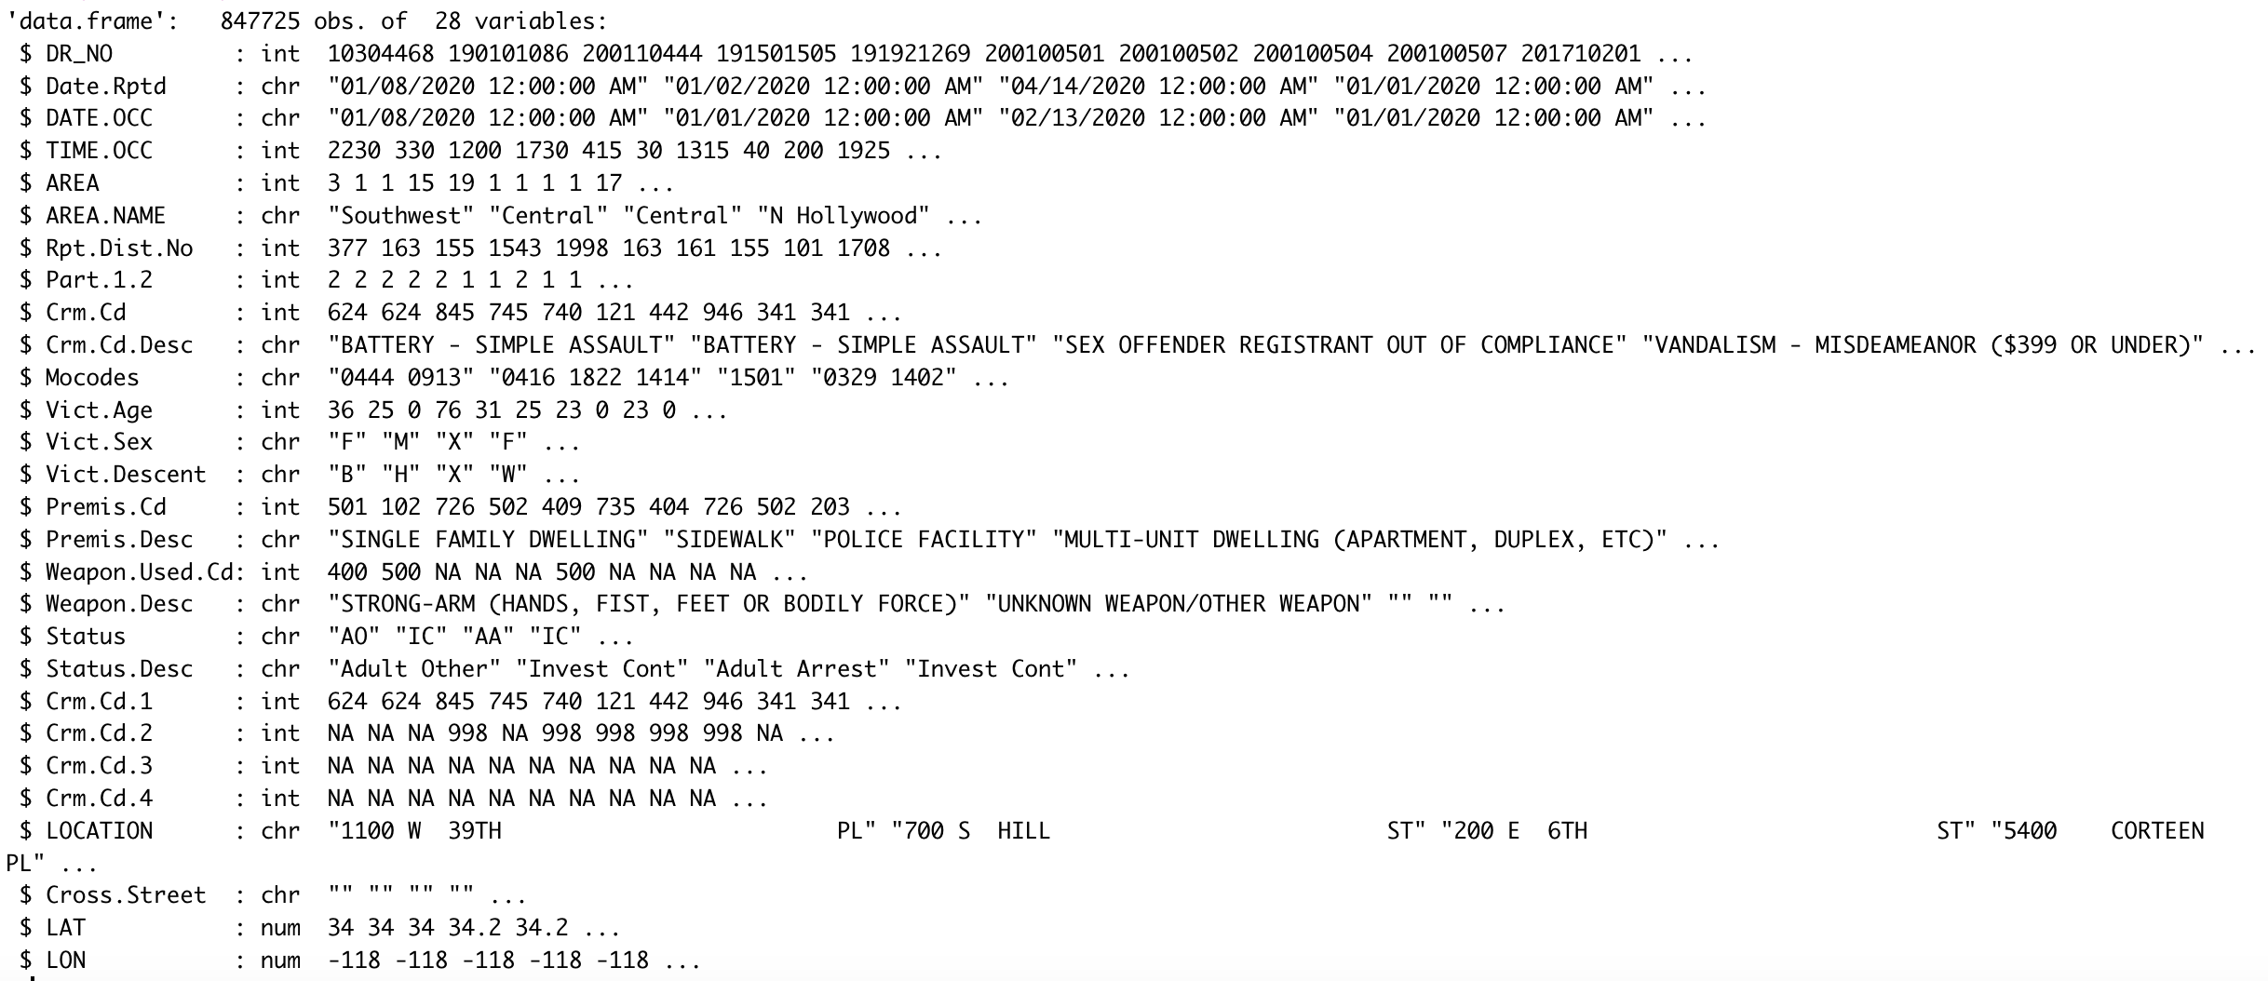
A Glimpse of our Data

Slide 8
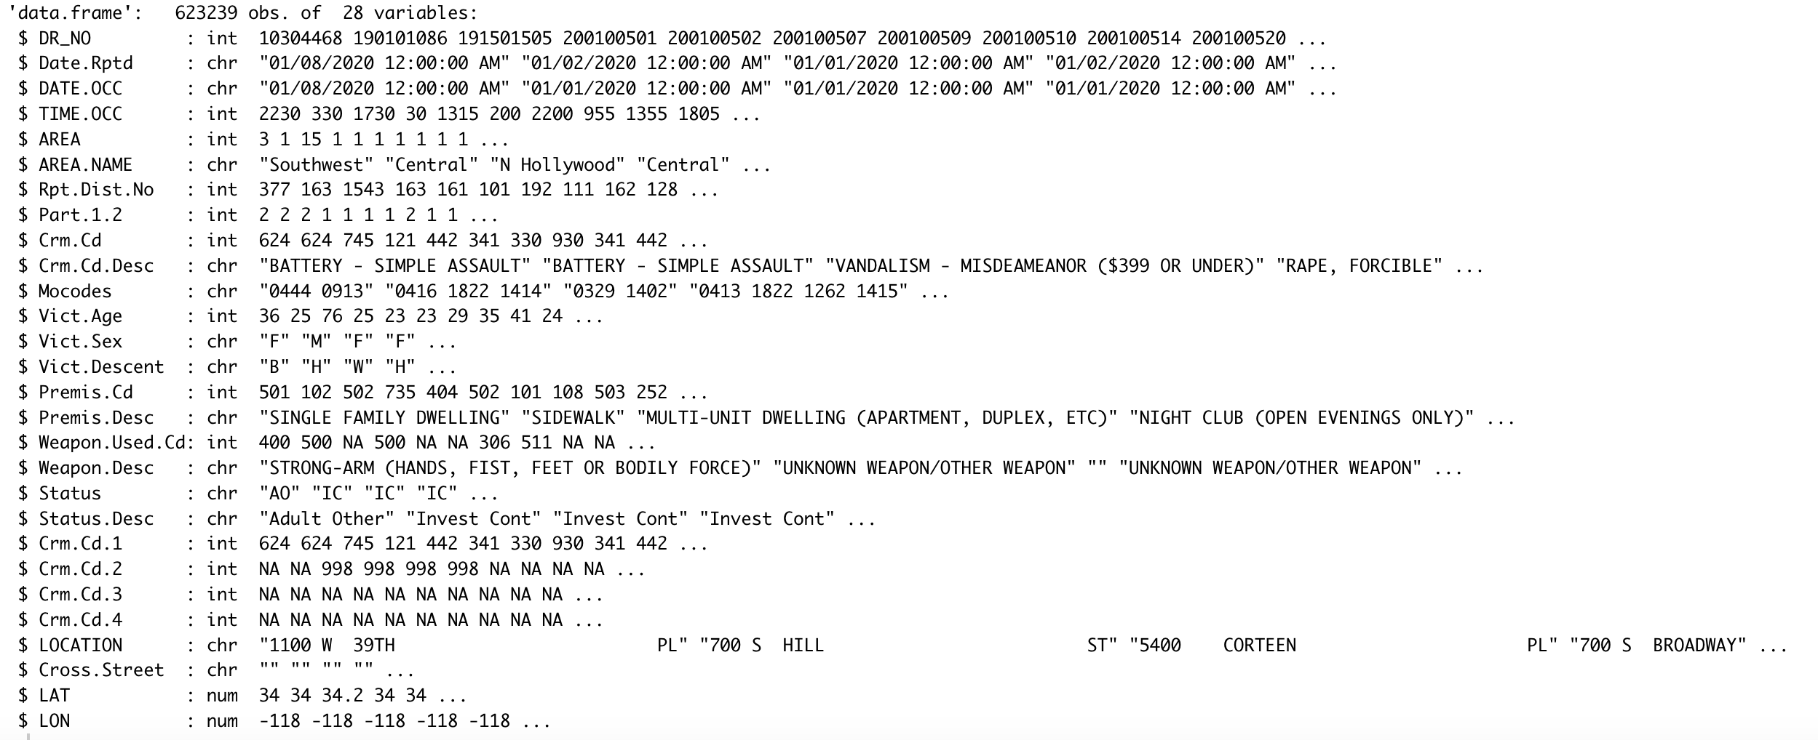
Cleaned Crime Data

Slide 9
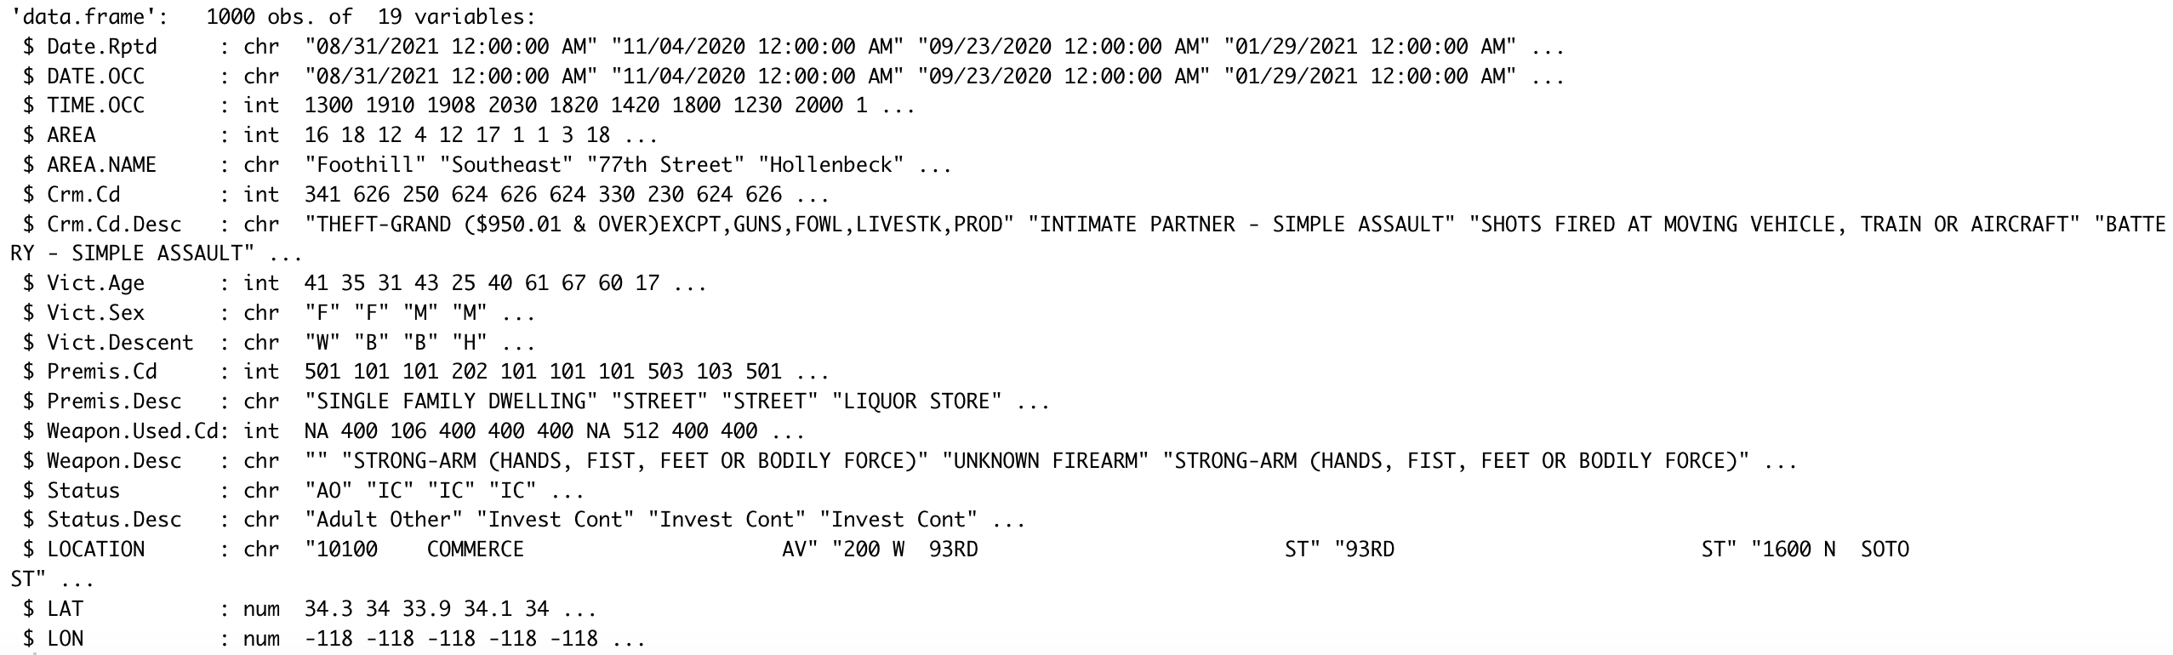
Our New Sample data

Slide 10
02
Descriptive Analysis

Slide 11
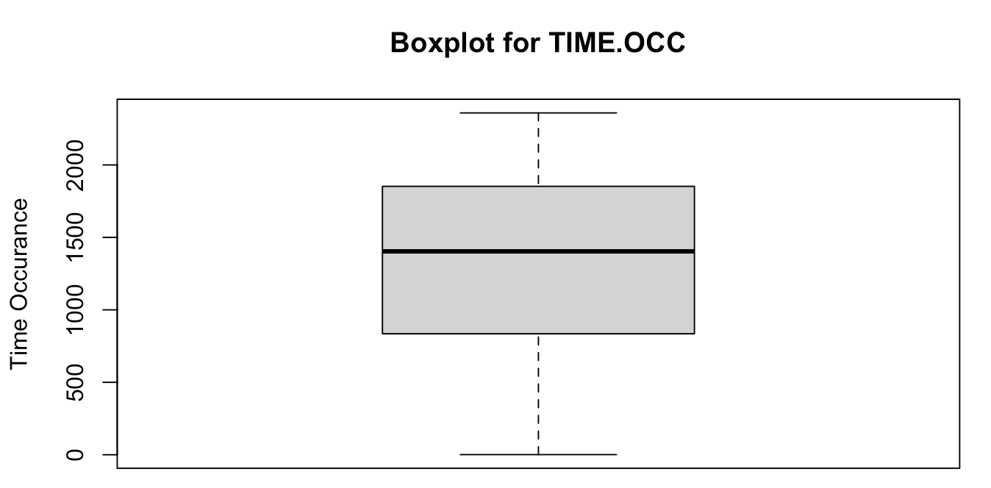
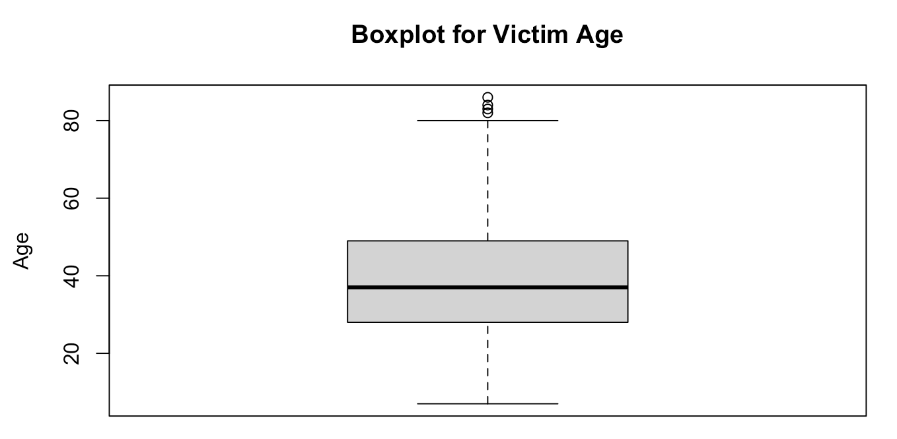
Boxplot Analysis

Slide 12
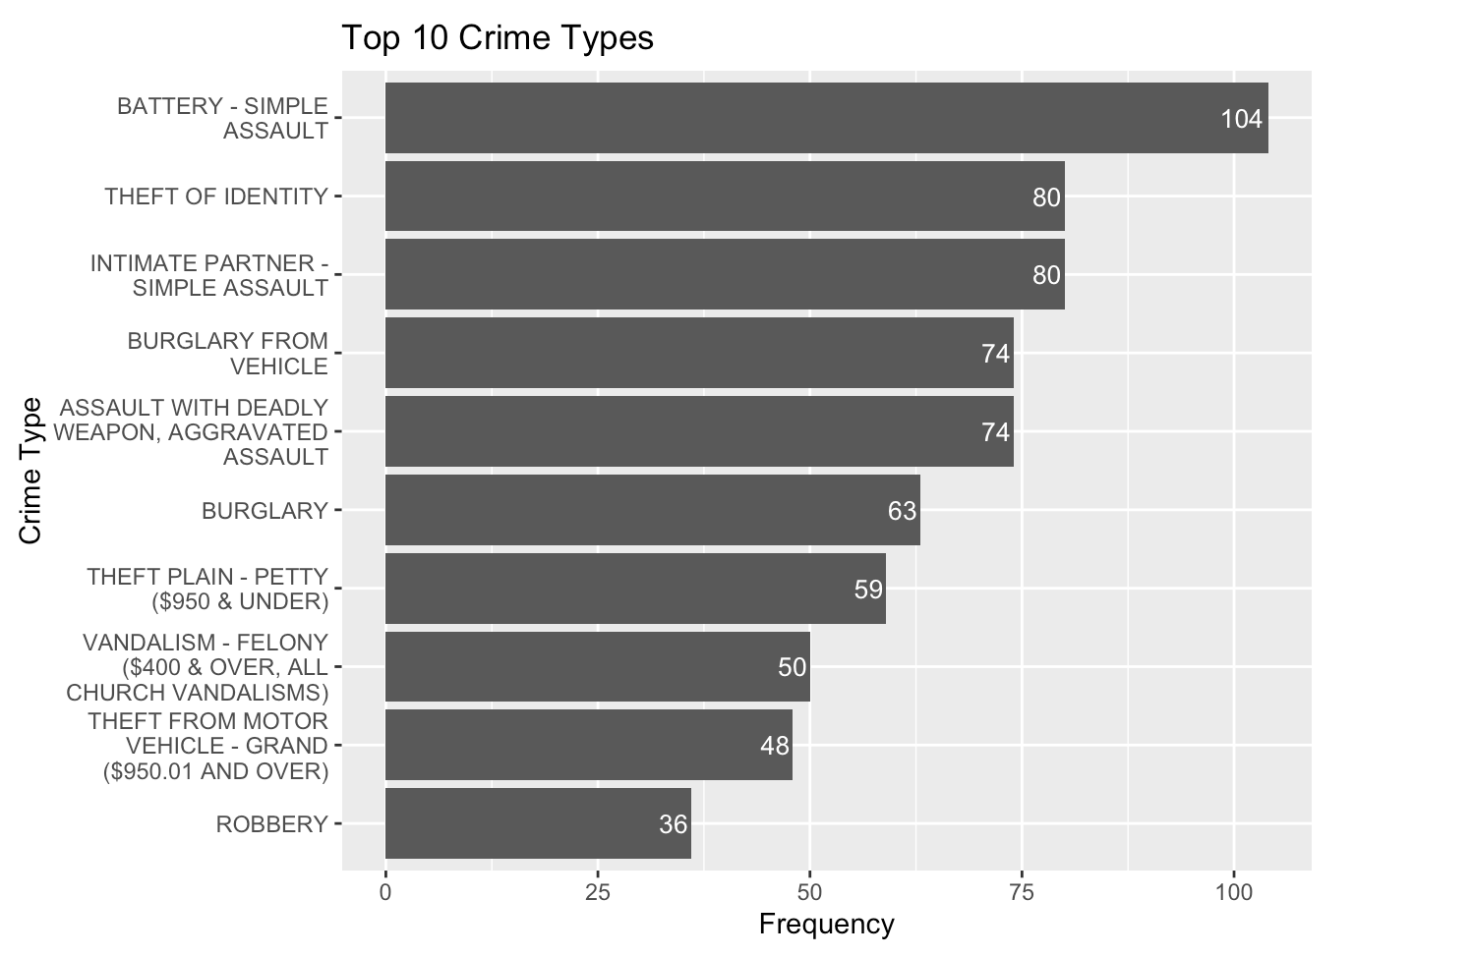
Top 10 Crime Types Barplot

Slide 13
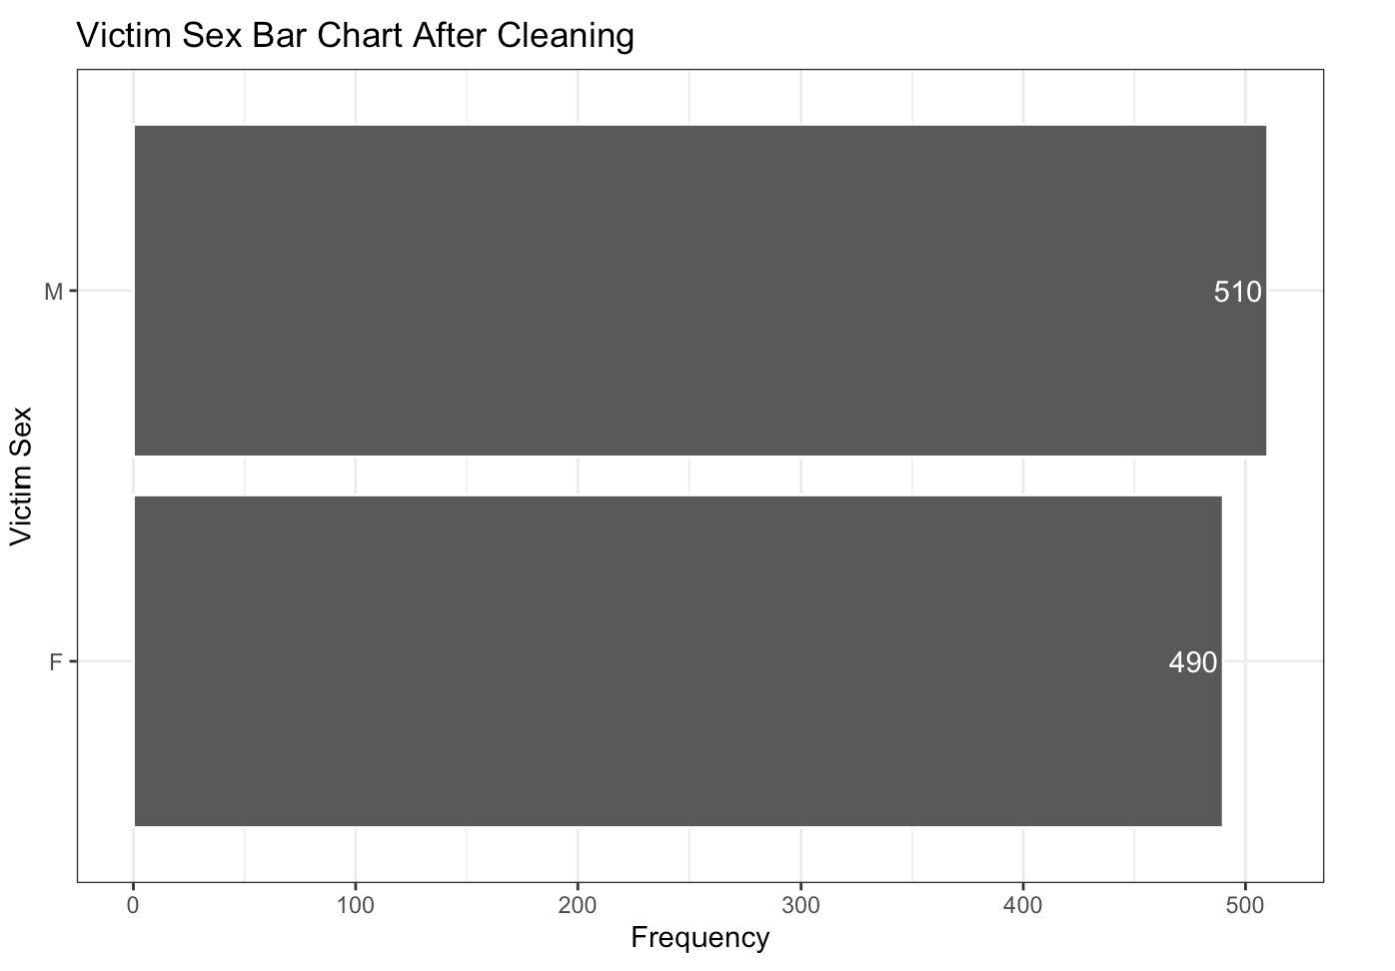
Victim Sex Barplot Distribution

Slide 14
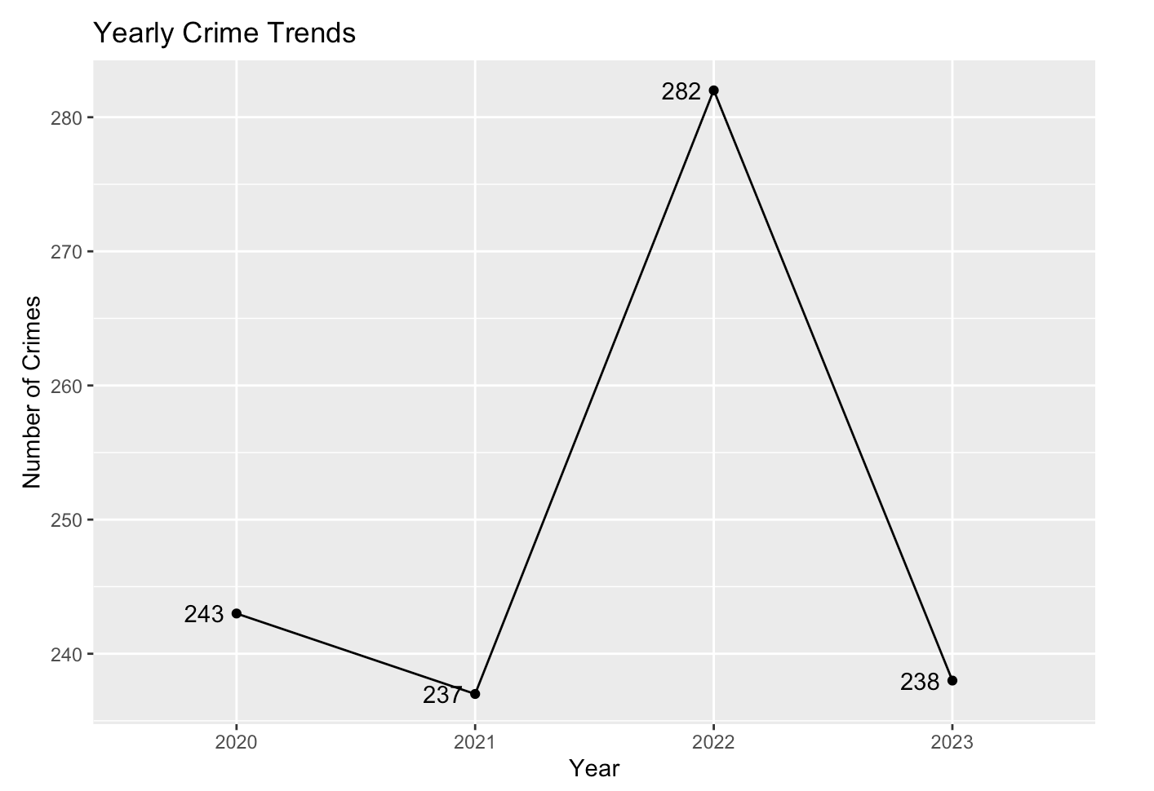
Yearly Crime Trends

Slide 15
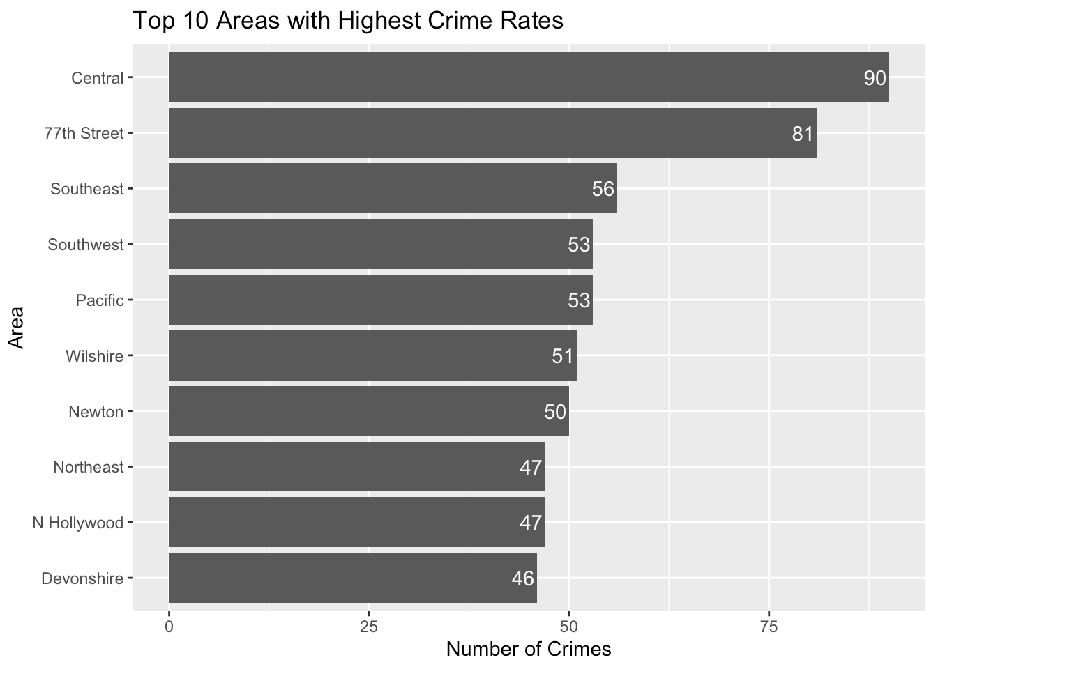
Top 10 Most Areas with Highest Crime Frequency

Slide 16
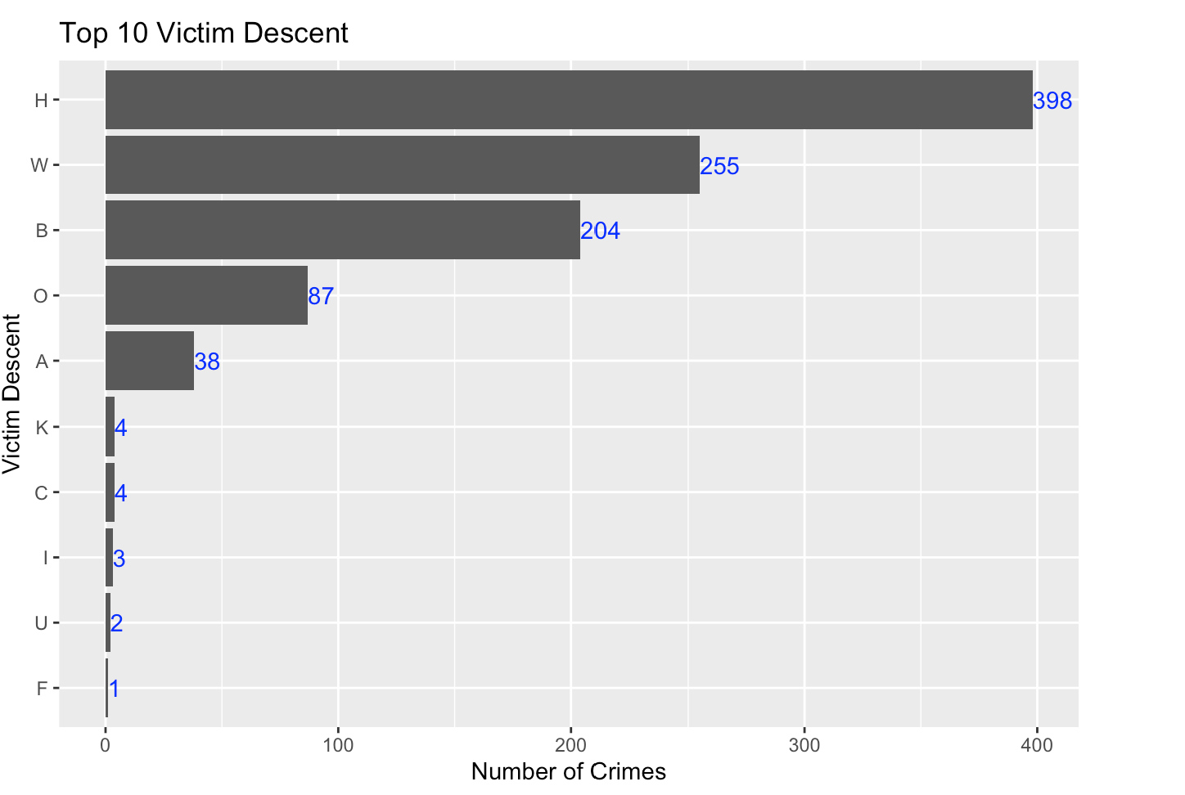
Top 10 Victim Descent

Slide 17
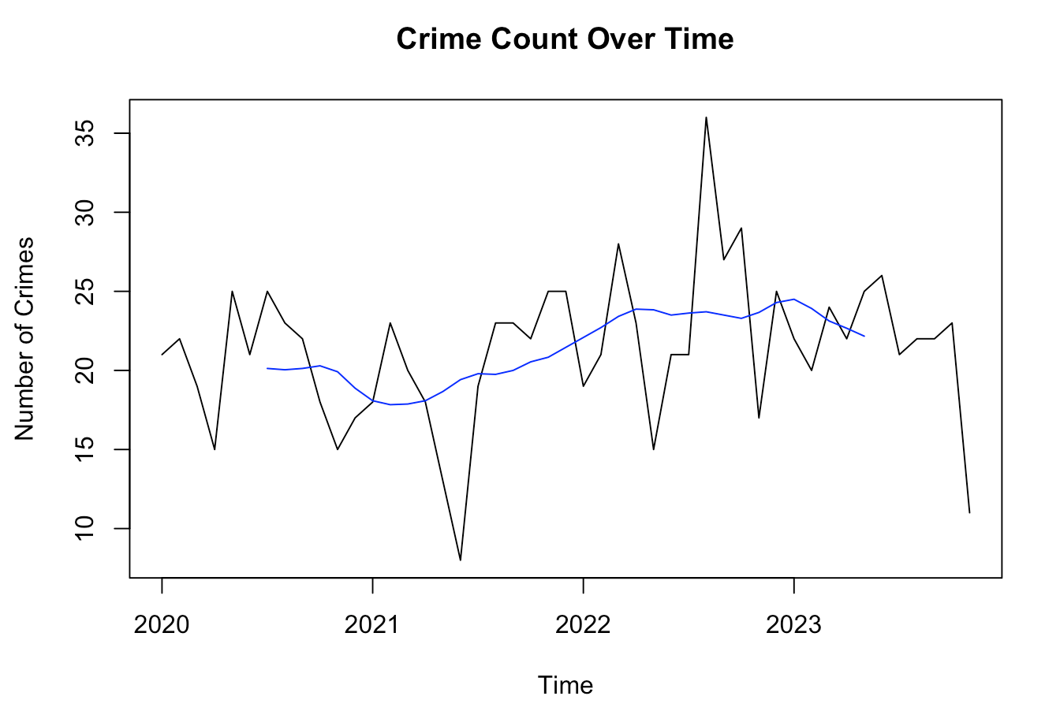
Time-Series Analysis

Slide 18
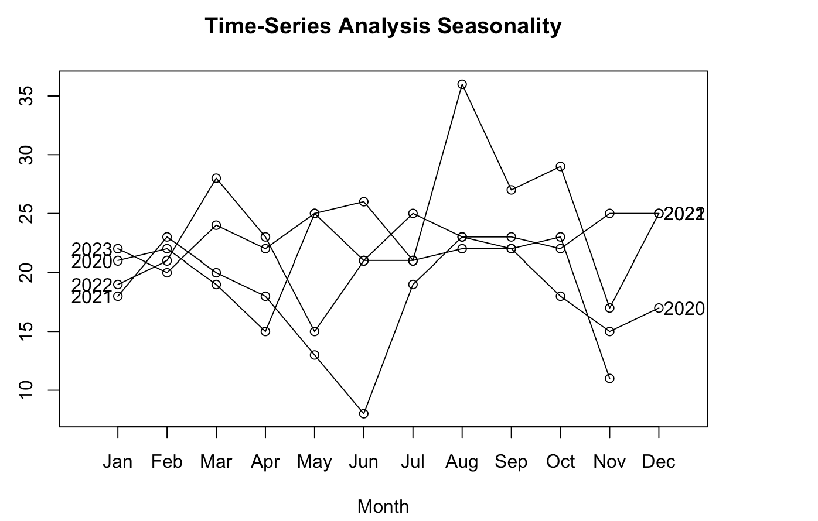
Time-Series Analysis

Slide 19
03
Model

Slide 20
Multiple Linear Regression Model
Dependent Variable
Independent
Variable
Total crimes
Medium income,
Population density,
Total population, Unemployment rate,
Sex percentage

Slide 21
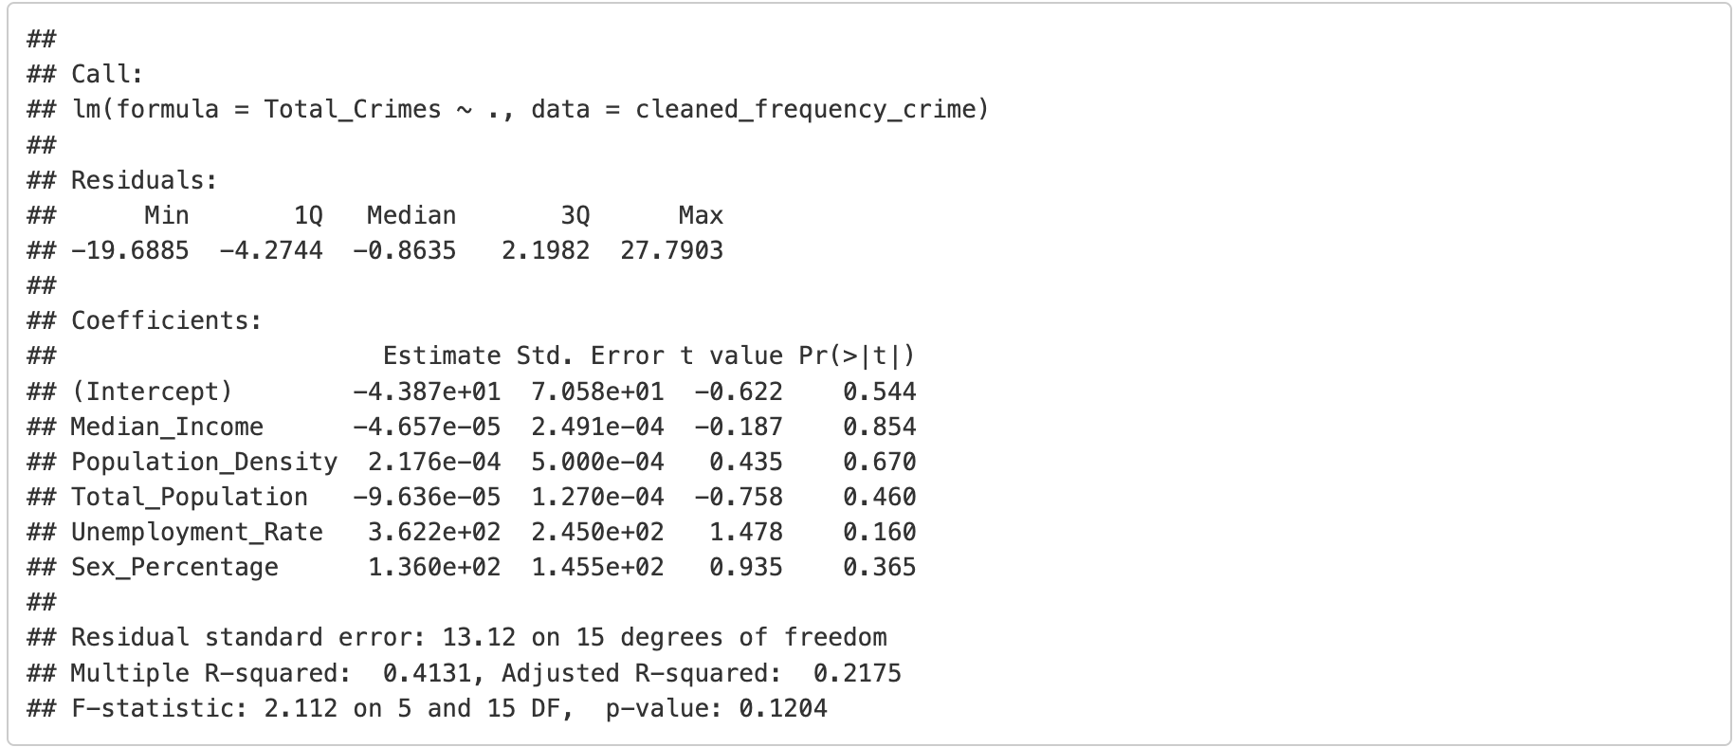
MLR - Model 1

Slide 22
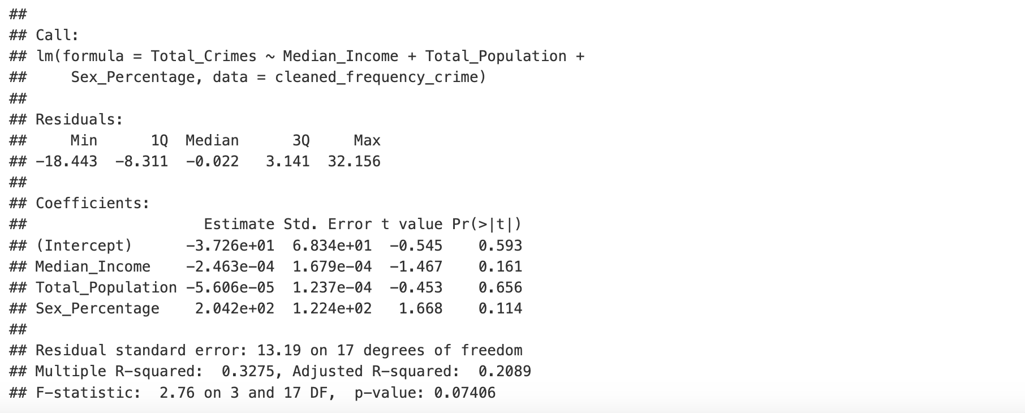
MLR - Model 2

Slide 23
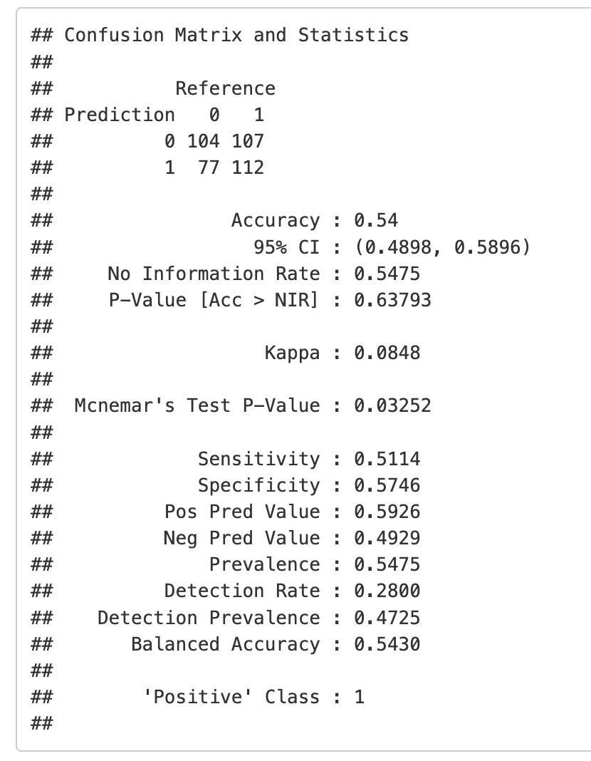
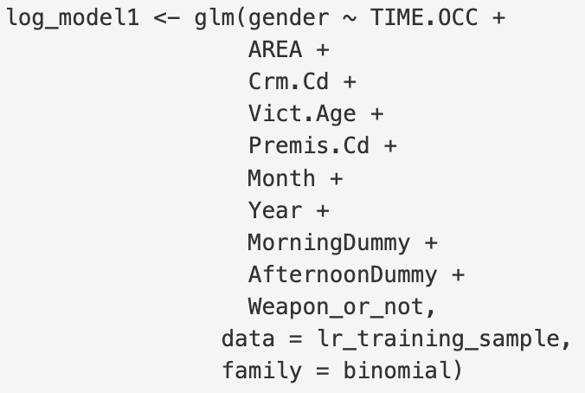
Logistic Regression——Model1

Slide 24
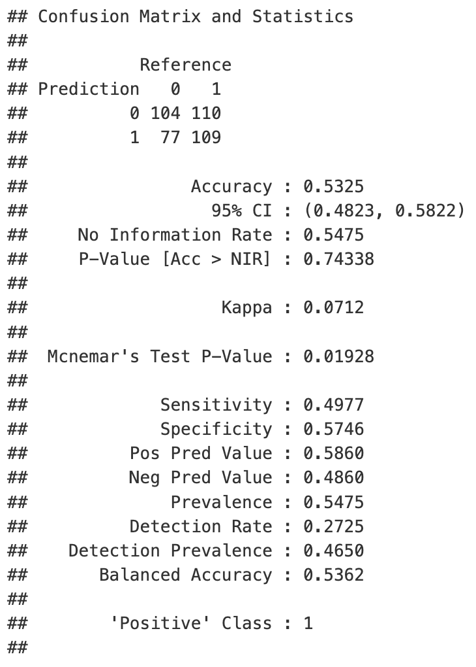
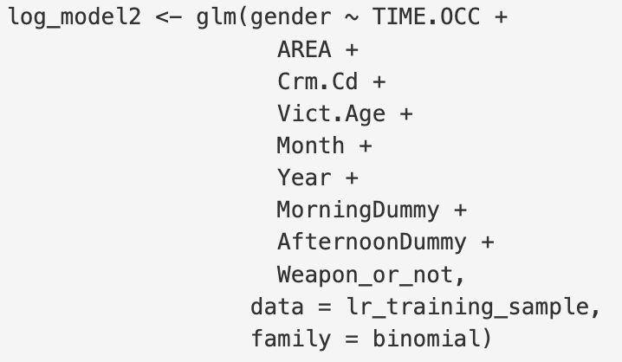
Logistic Regression——Model2

Slide 25
K-nearest Neighbors Model
Cross Validation​
K=10
Dependent Variable
Independent
Variable
Gender
Area, Crime code,
Vict age, Month, Year,
Time slot,
Morning,
afternoon,
weapon
Female 0
Male 1

Slide 26
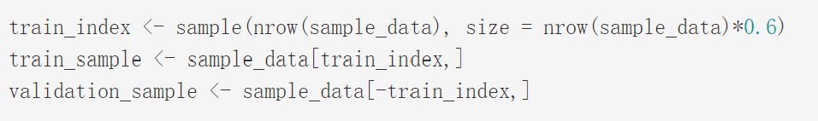
K-nearest neighbors model
60%
40%
Training data
Validation data

Slide 27
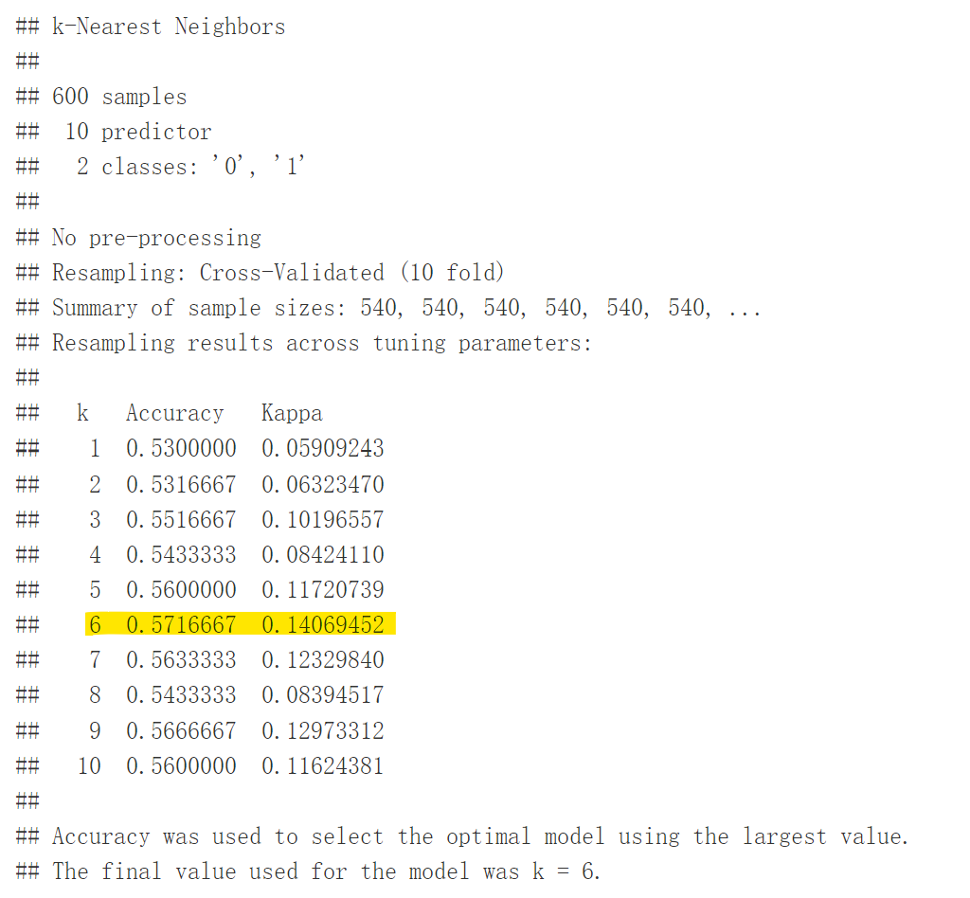
K-nearest neighbors model

Slide 28
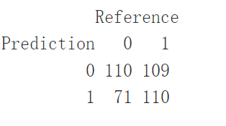
KNN--Predicting
Accuracy: 0.55
Sensitivity : 0.5023
Specificity : 0.6077

Slide 29
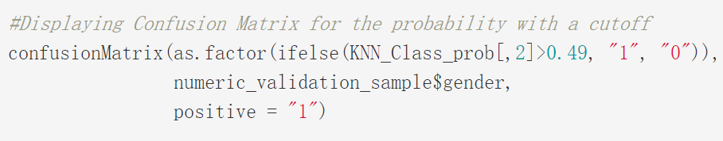
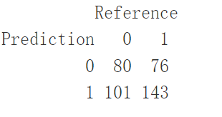
KNN---Predicting
Accuracy: 0.5575
Sensitivity : 0.653
Specificity : 0.442

Slide 30
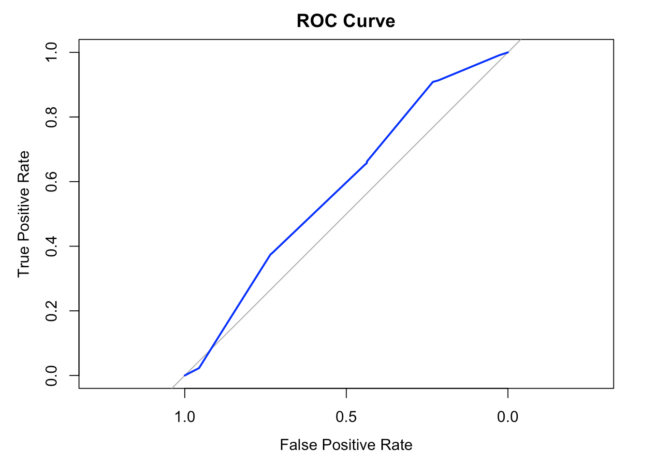
AUC=0.5804
KNN---ROC Curve

Slide 31

—Thomas Redman
“Where there is data smoke, there is business fire.”

Slide 32
Summary
Challenge
Limitation

Slide 33
Thanks!
Do you have any questions?

